Slide 1
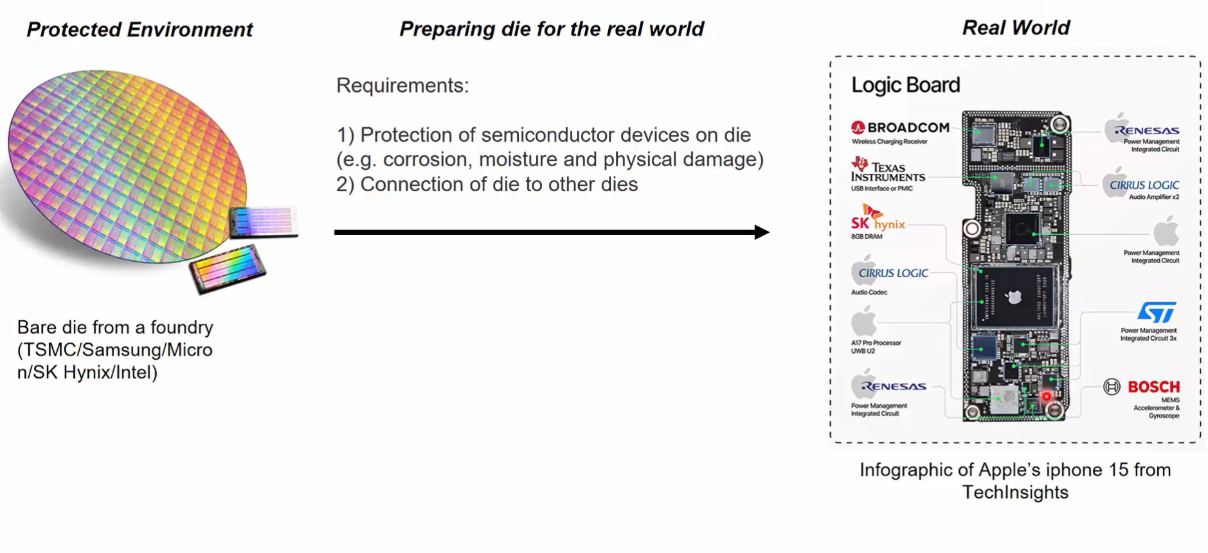
Nasscom Semiconductor
Semiconductor Packaging
Why semiconductor packaging required ?
Bare die come to foundry it’s only on wafer position so need to required protection of die or semiconductor devices on die(e.g corrosion, moisture and physical damage)
Connection of die to other dies through packaging.

Slide 2
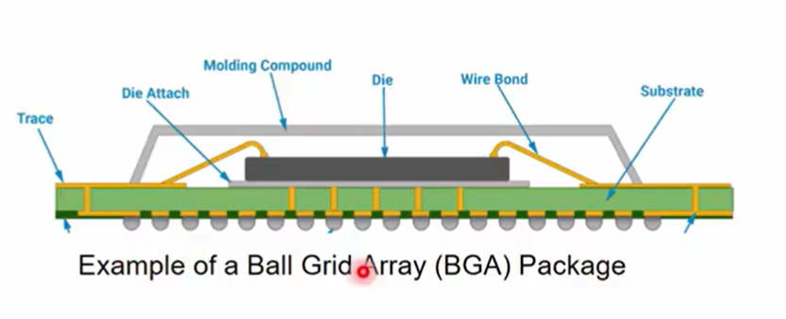
Introduction to Semiconductor Packaging
When die comes to from foundry it’s on wafer position, so protect die or semiconductor device on die required packaging.
In packaging system die put it on substrate with attaching glue or materials, and die connected to substrate with wire.
This wire stich from die to substrate make wire bond and another side of substrate is connection of BGA(Ball Grade Array) which is connected to PCB or another die.

Slide 3
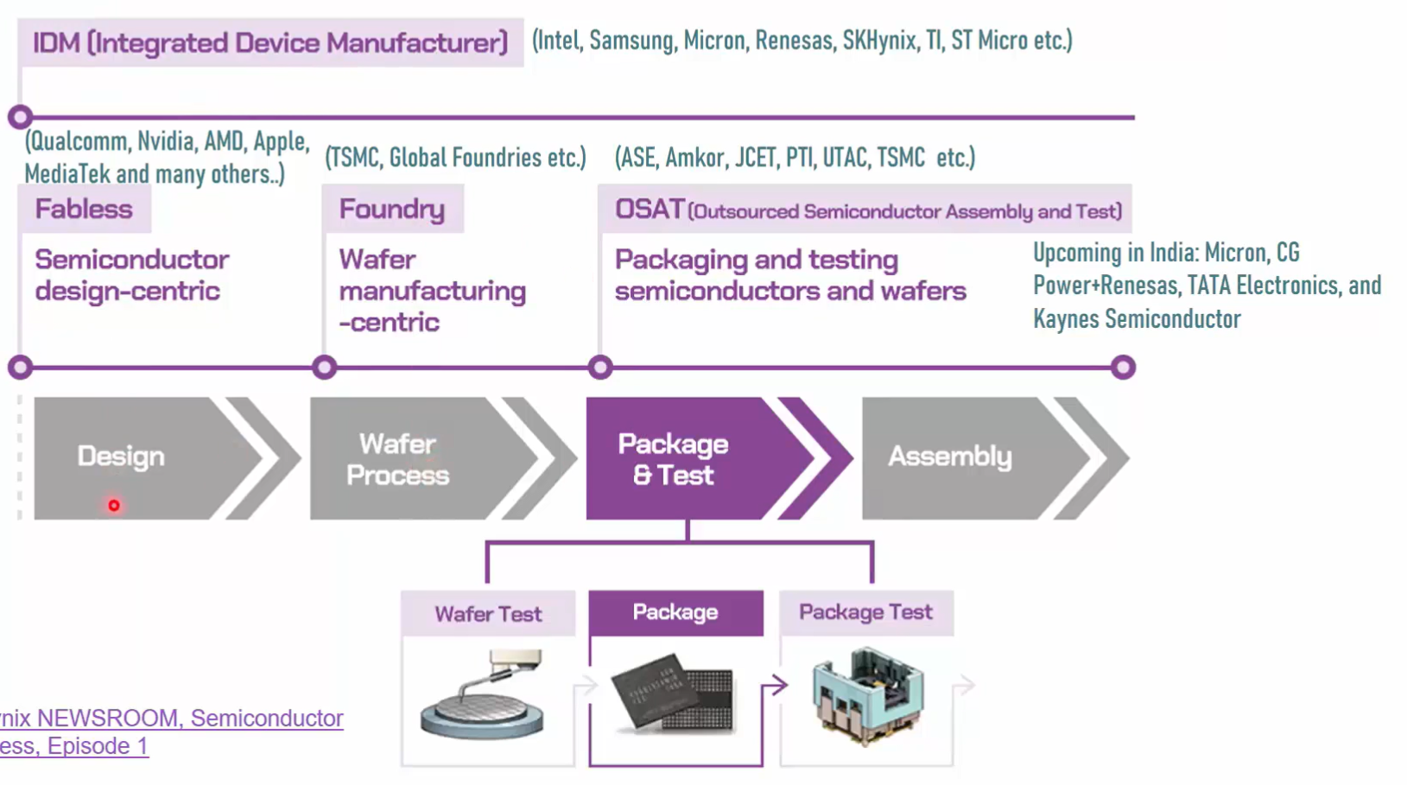
Package and Testing Industry
First part of semiconductor manufacturing is design where semiconductor design process done(e.g Qualcomm, Nvidia, AMD, Aplle) companies made the design.
Second phase of semiconductor is manufacturing where the wafer manufacturing done(e.g TSMC, Global Foundries) companies made wafer semiconductor.
Third phase of semiconductor is packaging where the packaging process done(e.g ASE, Amkor, JCET) companies made packaging of semiconductor.
Forth phase of semiconductor is assembly after packaging of semiconductor, it’s goes to assemble on PCB.

Slide 4
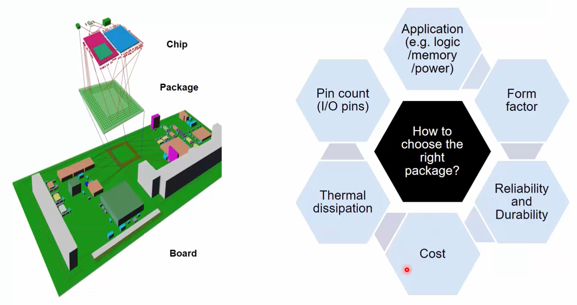
Product Requirement
First we required the die which is sit on the substrate and after that it’s assemble on board
So first thing was know about the application of semiconductor (e.g logic ,memory, power)
After that to check how fast working with other die or connect to other die on board.
Thermal dissipation is one of most important part in semiconductor because semi. sit on package and system and chip dissipation decided on this part.
Form factor is decided the area of package on board how munch size required of package.
Materials using in the package is decide to reliability or durability.
At last cost using the semiconductor technologies minimize the cost of packaging.

Slide 5
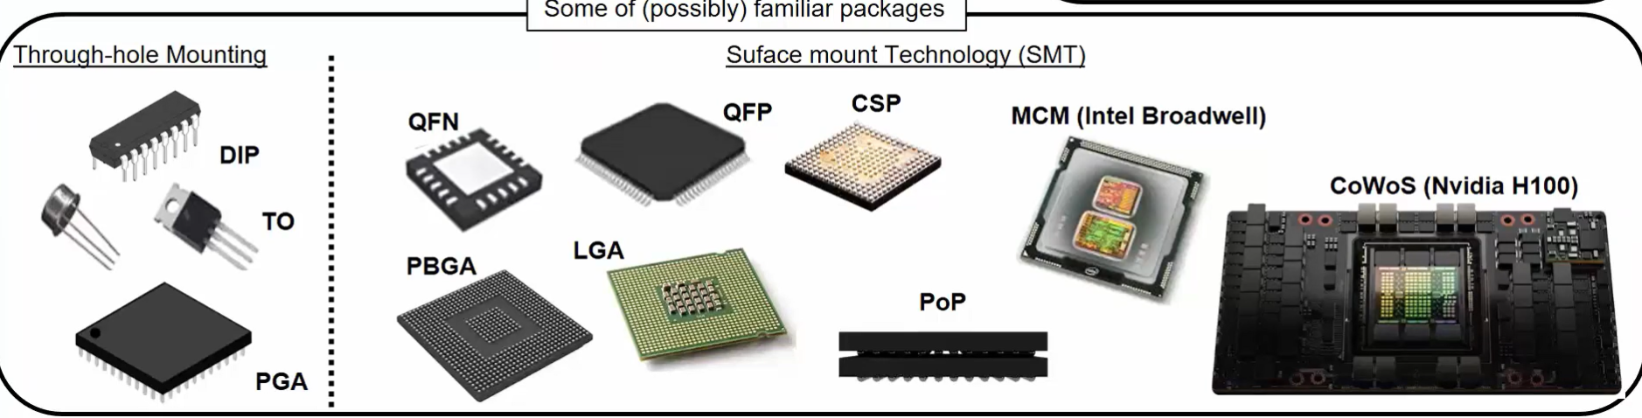
Typical package structure
There are two types of packages 1.Through hole Mounting 2.Surface mount technology
Through hole mount technology a DIP(Dual inline pin) ,TO (Transistor Outline), PGA(Pin Grade Array) package are use where pins are directly connected to PCB hole.
In surface mount technology a QFN(Quad flat no lead), QFP(Quad flat pin), PBGA(plastic ball grid array), LGA(lane grid array), CSP(chip scale pin), pop(package on package), MCM(multi chip module) where IC mounted on surface of PCB.

Slide 6
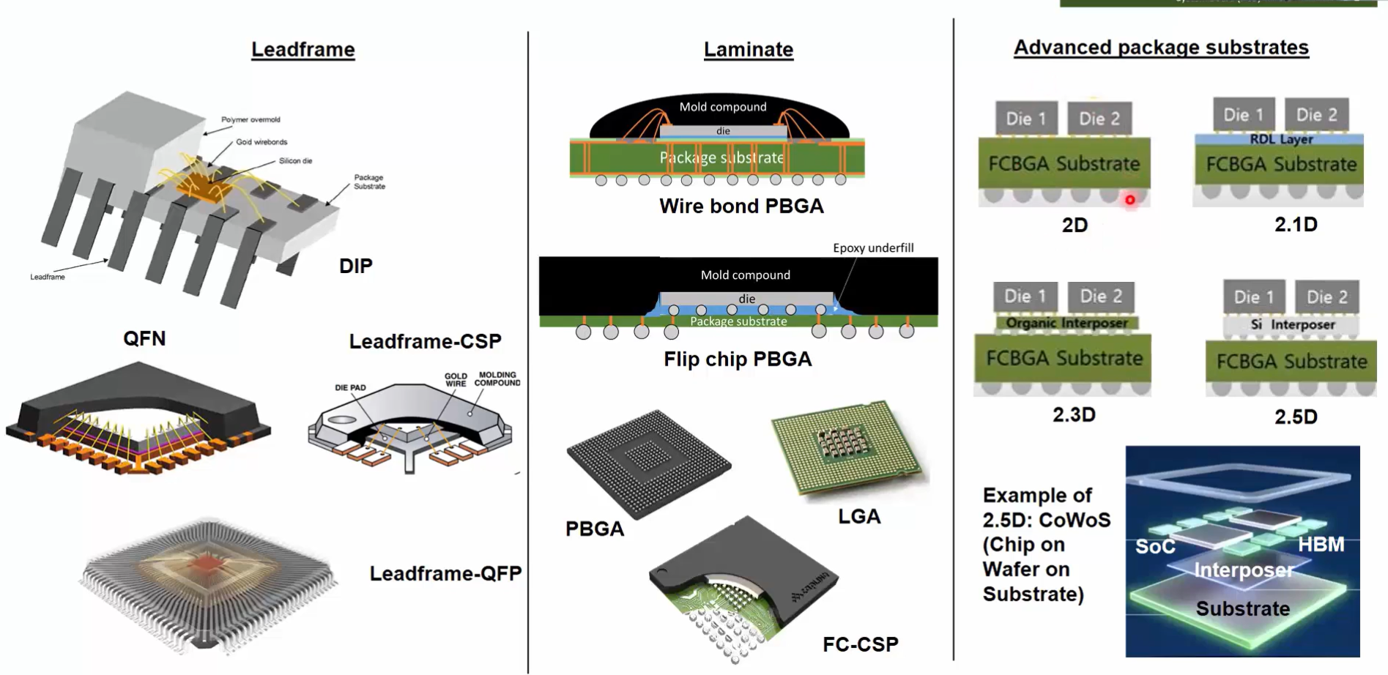
Anatomy of Package
In lead frame technology lead are come out of the chip and die is connected to pin through wire bond.
In this technology IC connected to PCB through a lead.
In laminated technology PBGA a die is connected to package or substrate and substrate to ball grade array , all this connection through a wire bond, where wire stitching form die pad to substrate and substrate to stitch plastic ball.
Another technology is bump or flip chip PBGA in this technology die and substrate is connected through a epoxy materials and bump is inside the epoxy which is connected between die and substrate and bump is connection to a plastic ball through the substrate.
Where in advance package substrate two die on substrate connected through a substrate to ball grade array and BGA to substrate to connection on second die this is in 2D package system.
In 2.1D package die is connected to the substrate RDL Layer , in this packaging system die to die connection through a RDL Layer.

Slide 7
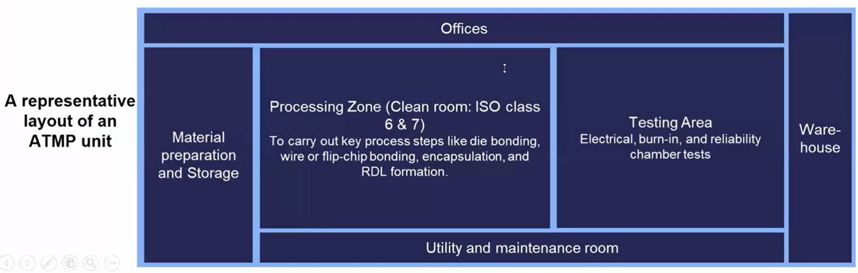
Introduction of package manufacturing unit
In package manufacturing unit have ATMP unit where a assembly, testing , marking, and packaging process done.
ATMP unit have materials preparation and storage area, utility and maintenance room , process zone it’s call clean room which is regulate the ISO class 6&7, In this area to carry out the key process like die bonding, wire and flip-chip bonding, encapsulation, RDL formation.
And after have testing area where a electrical, burn-in, and reliability chamber test done
At last have a warehouse materials out for the assemble.

Slide 8
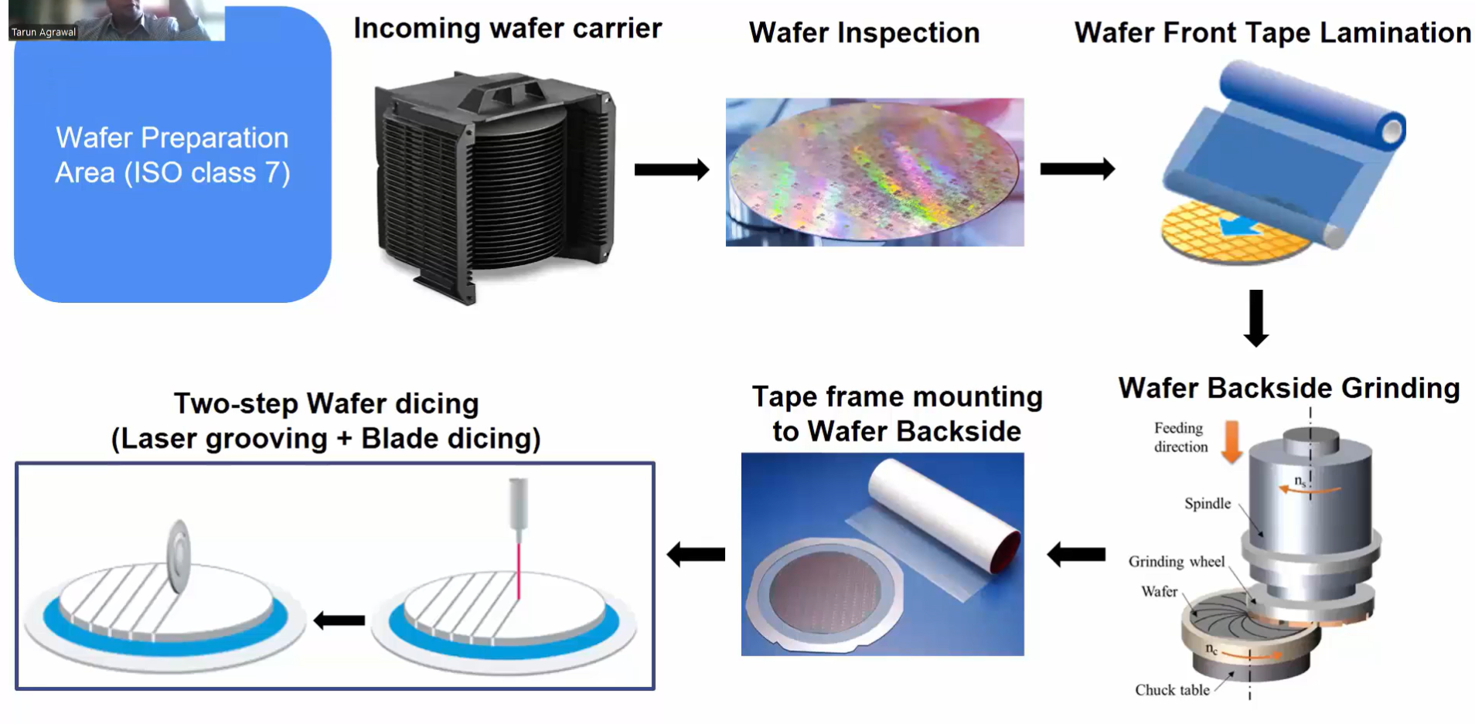
Process inside the clean room
At first wafer arrived in wafer carrier and wafer goes to in inspection phase after the inspection wafer are laminated through a tape a lamination part of wafer is front side where circuit is available, because in this process we need to protect circuit area of wafer and hole the remaining process done on back side where the substrate is available.
After the lamination process, wafer goes to griding process where the griding of wafer and cutting of silicon process done.
After the griding process done tape frame mounting process to wafer back side done.
After that wafer dicing process done wafer are cutting through the blade or laser grooving.

Slide 9
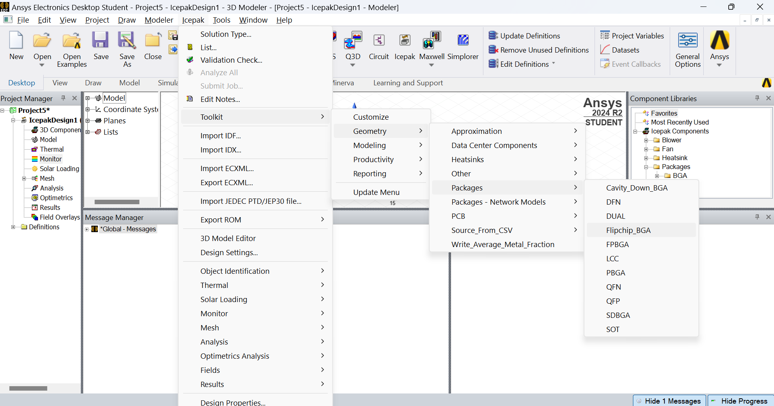
Flip-chip package using a Ansy electronics desktop tools
So step to open ansys tools > icepack menu > Toolkit > Geometri > Packages > Flipchip_BGA

Slide 10
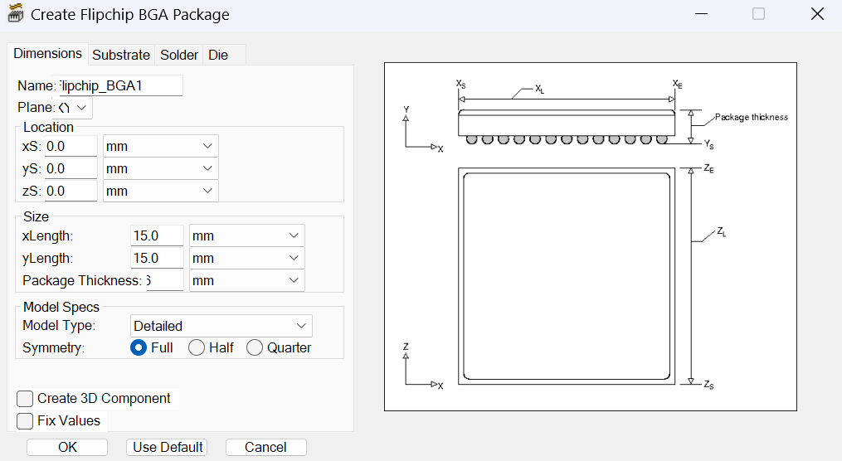
When open Flipchip-BGA below dialog box are open

Slide 11
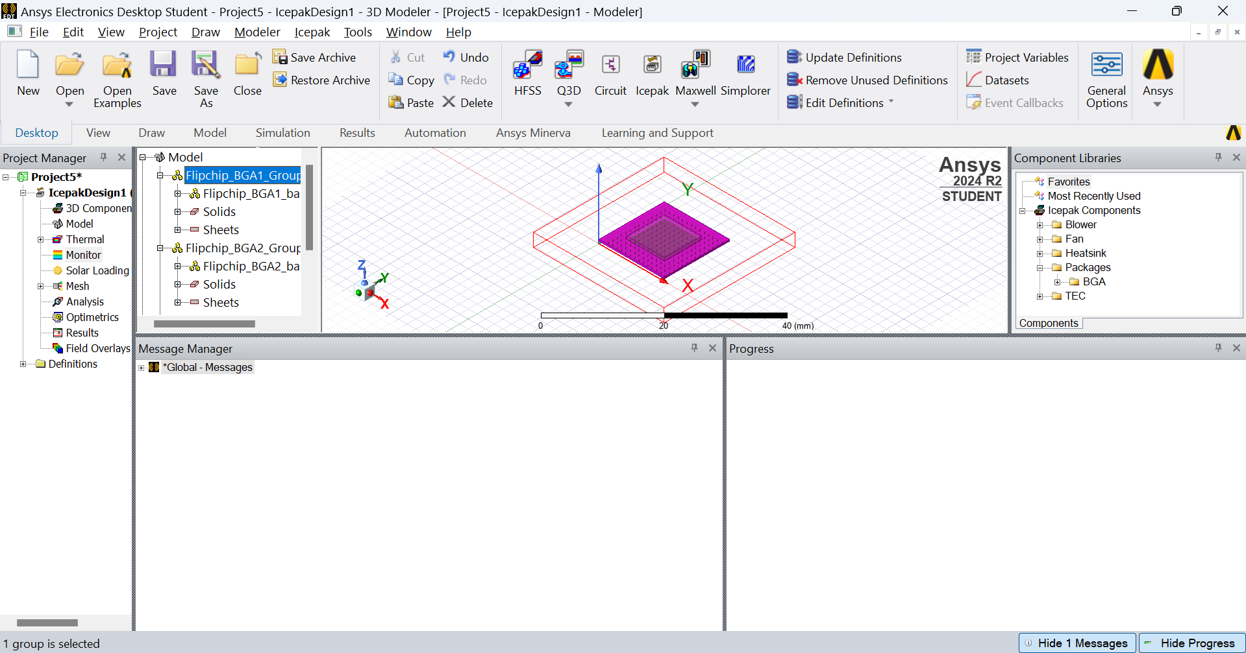
After the doing all setting in packaging show like below image

Slide 12
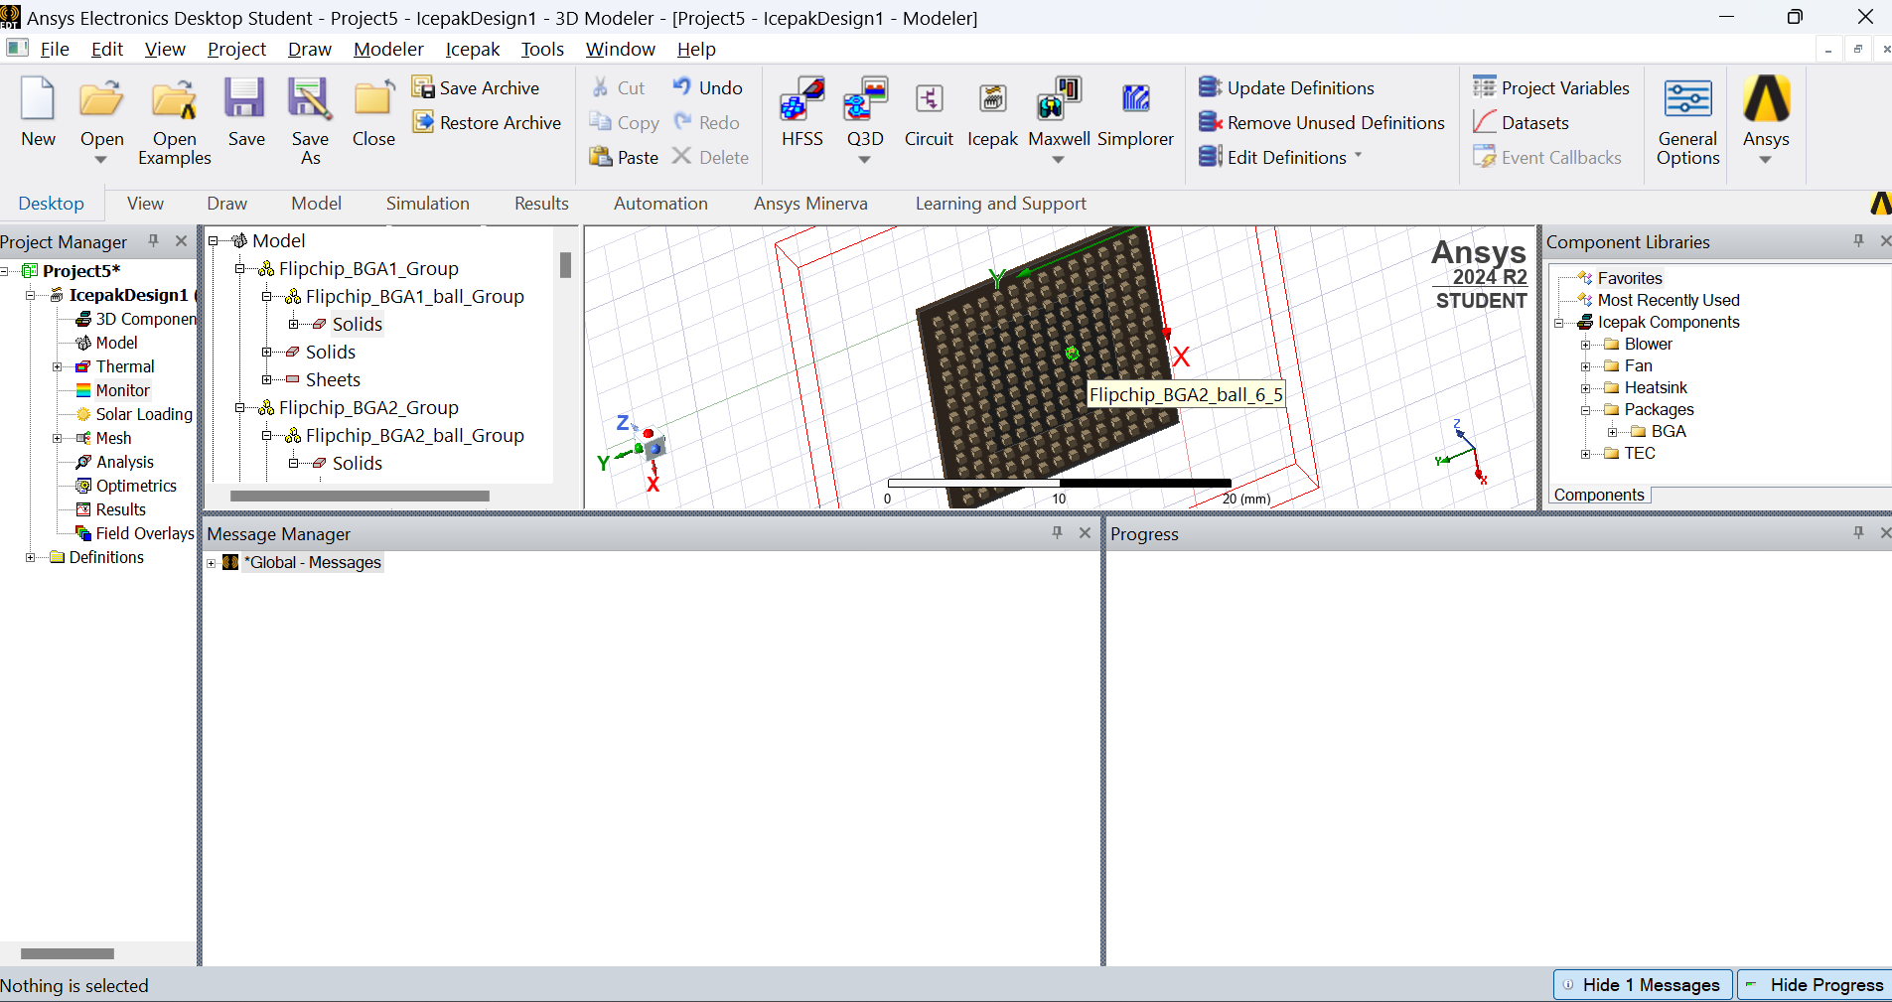
Backside of the chip BGA

Slide 13
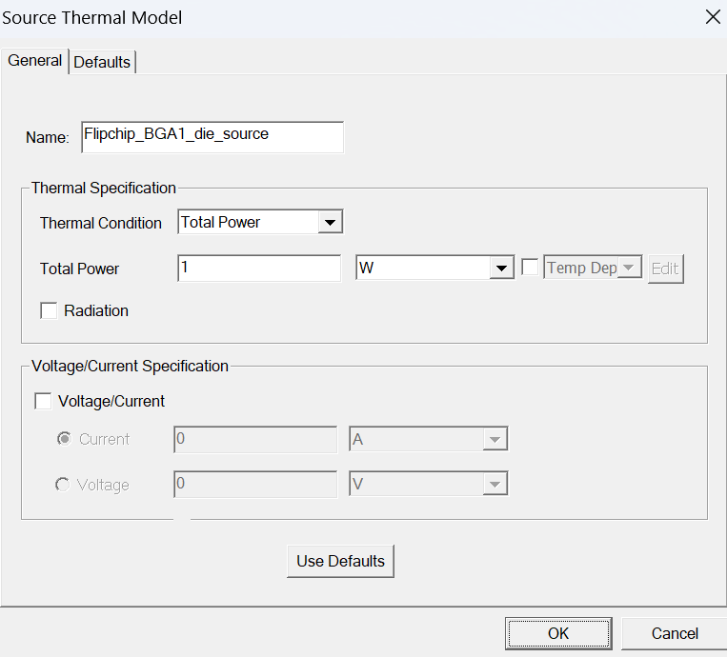
Thermal condition check > Flipchip
-BGA1_die_source

Slide 14
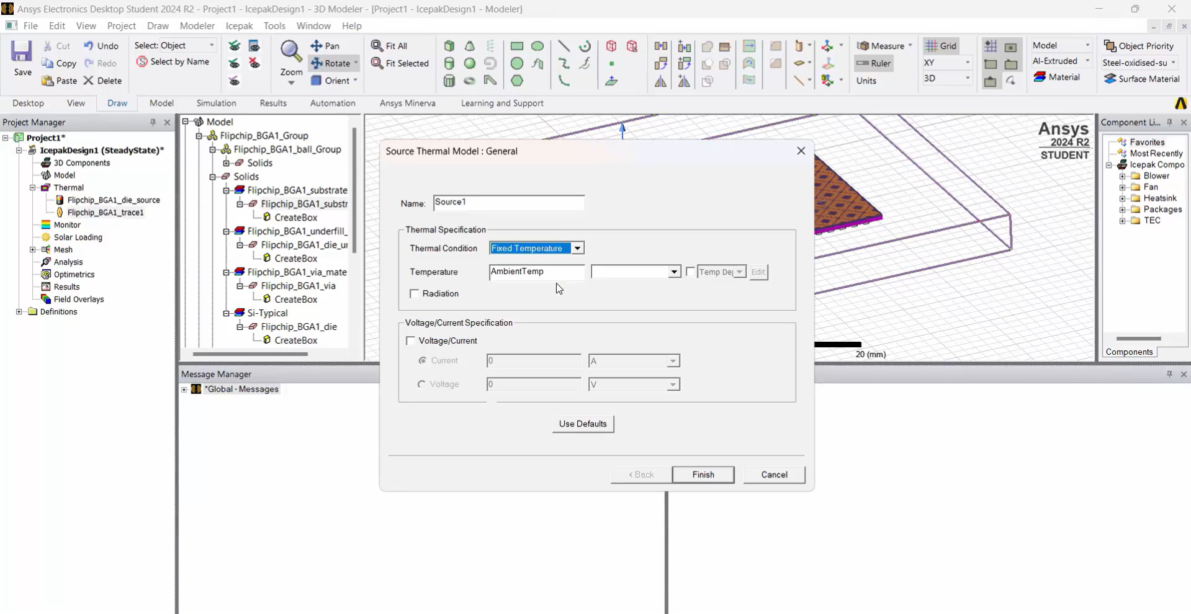
Another condition added for thermal condition > Flipchip_BGA1_trace1 > Flipchip_BGA1_substrate >thermal dissipation > source > select fixed temperature > select ambient Temp

Slide 15
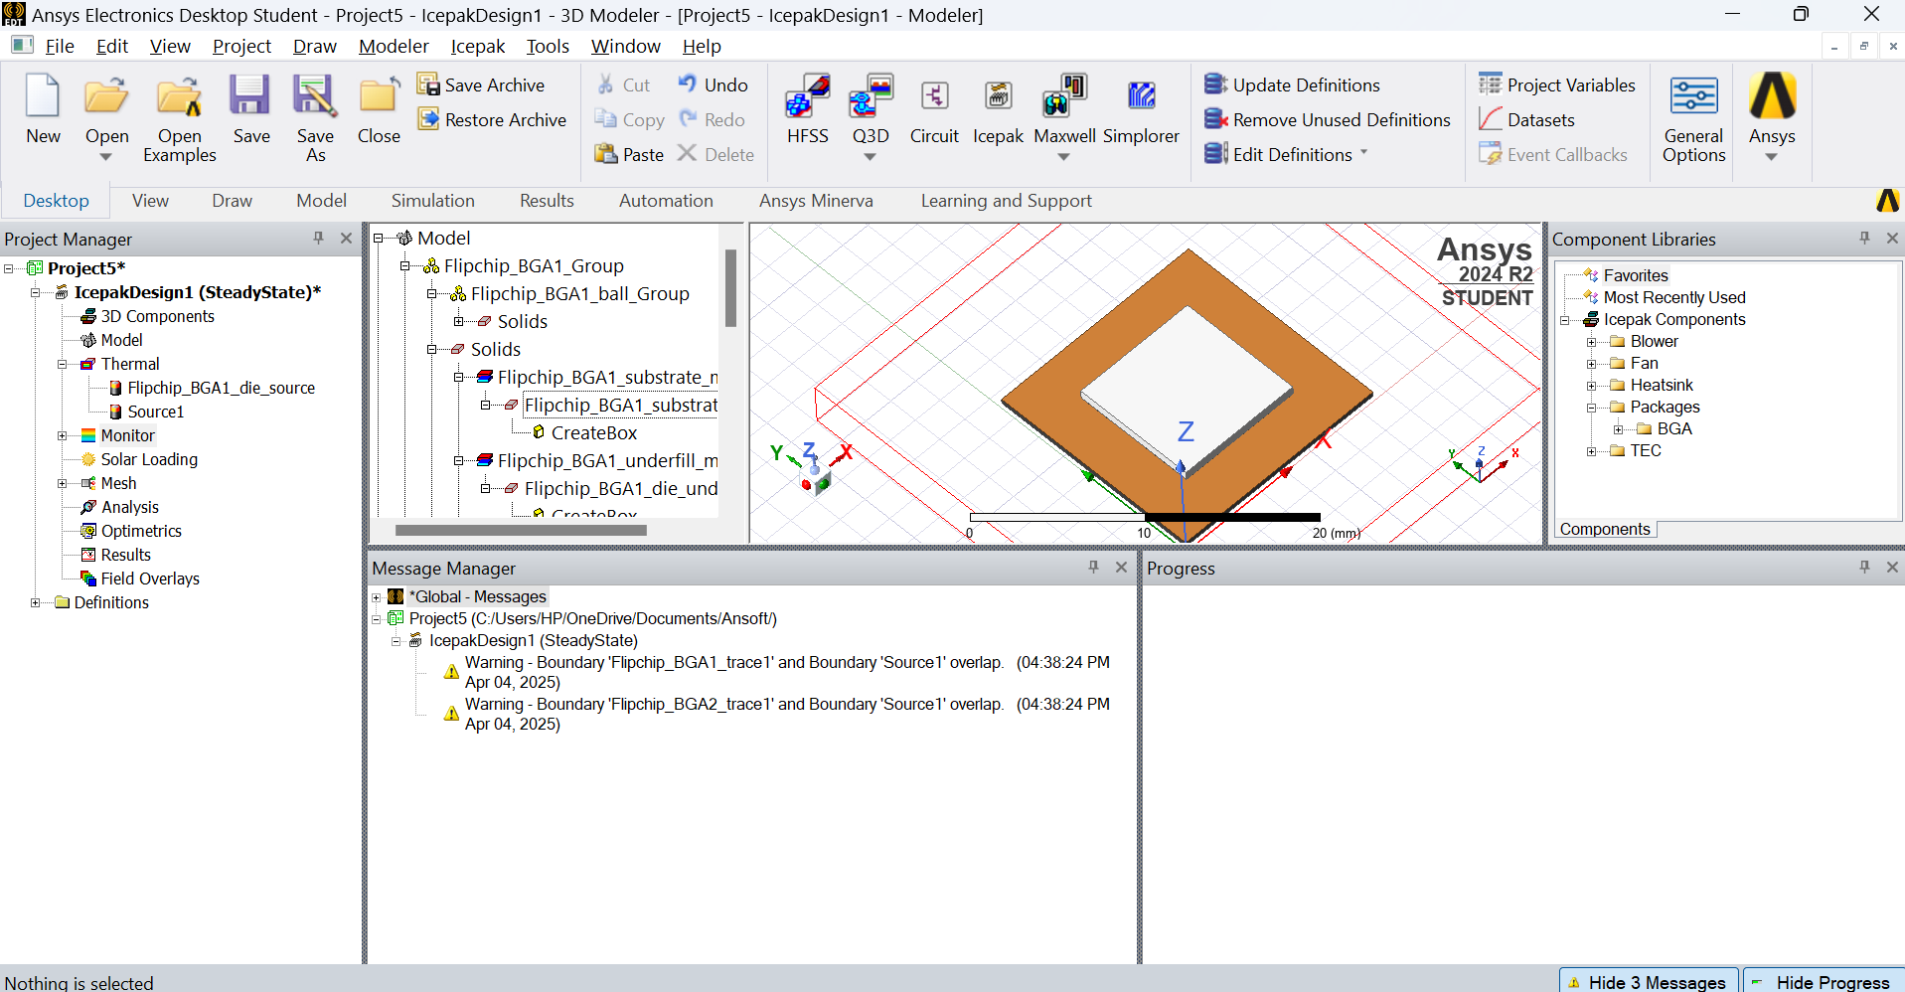
After that assign the monitor > select monitor > select done
After open the Flipchip_BGA1_substrate > assign monitor > point > temperature

Slide 16
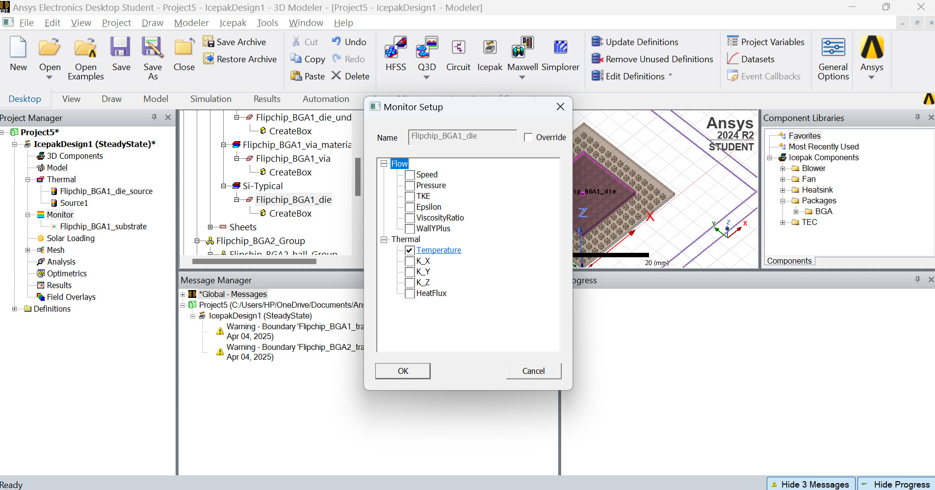
Same thing have done with assign Si –Typical > assign monitor > point > temperature

Slide 17
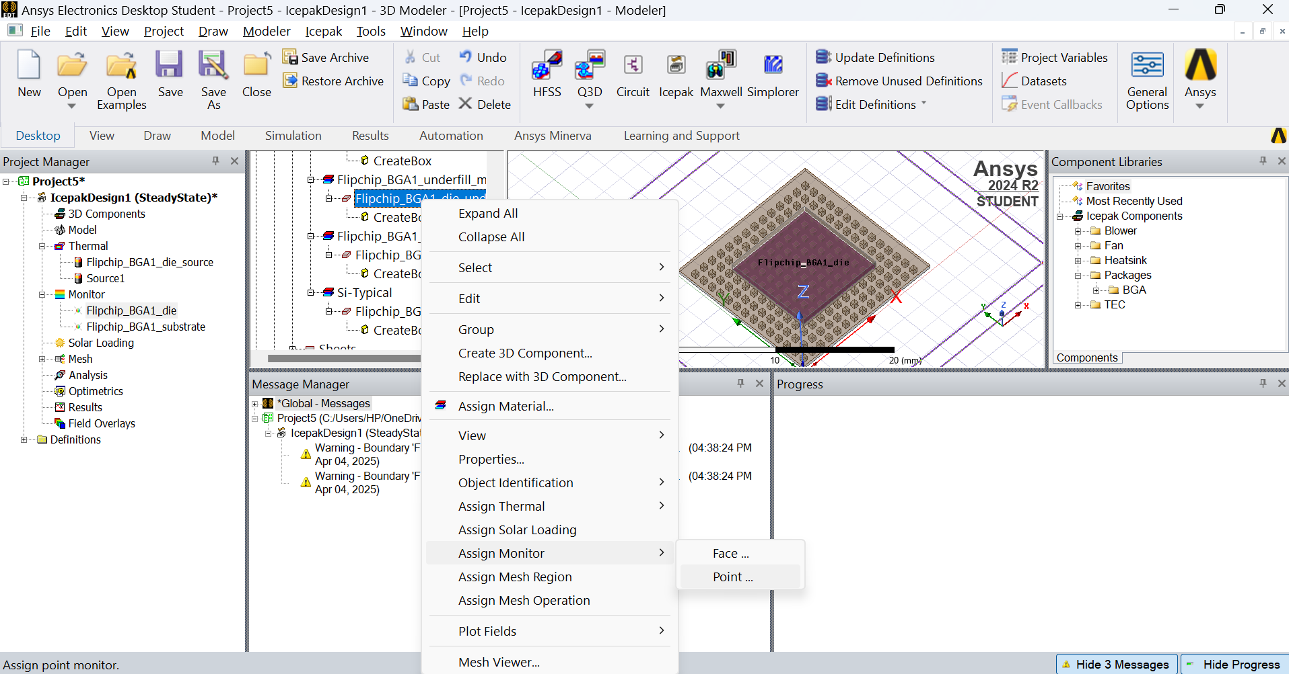
Assign the underfill > Flipchip_BGA1_underfill >assign monitor >point > Temperrature

Slide 18
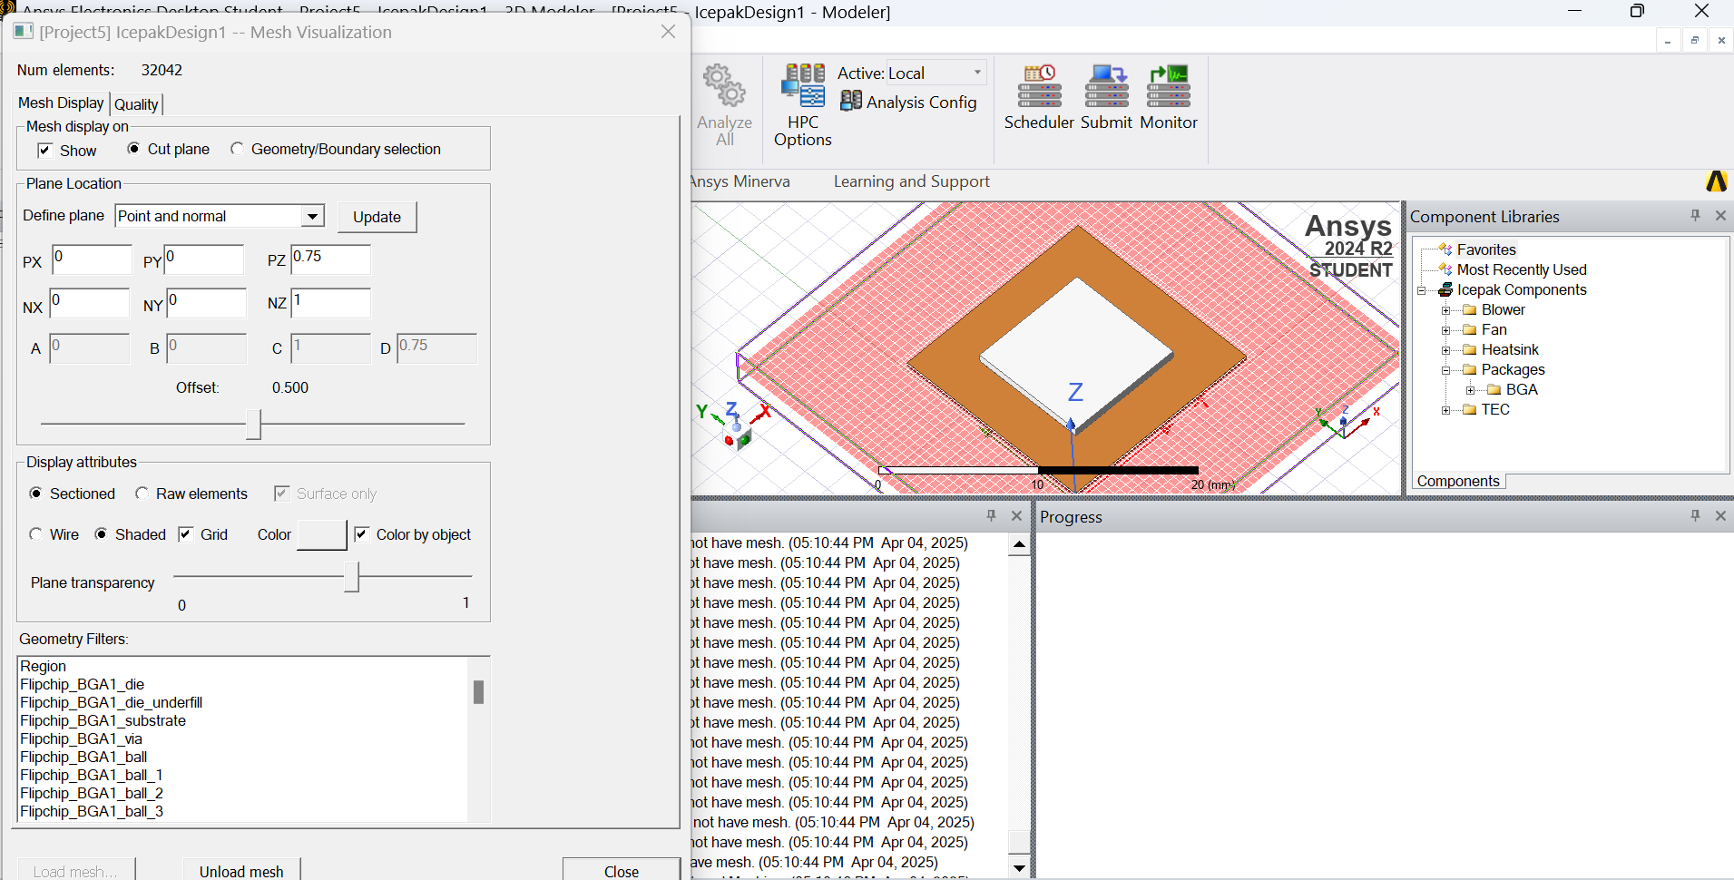
Mesh and analysis
Mesh > generate mesh > project

Slide 19
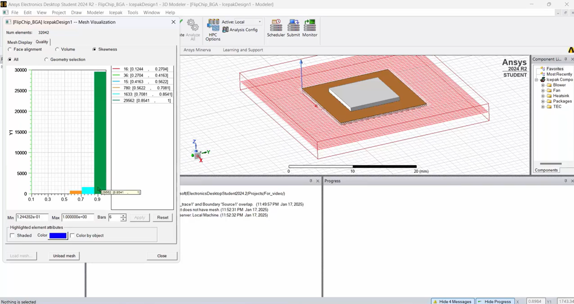
In mesh we can see quality of mesh.

Slide 20
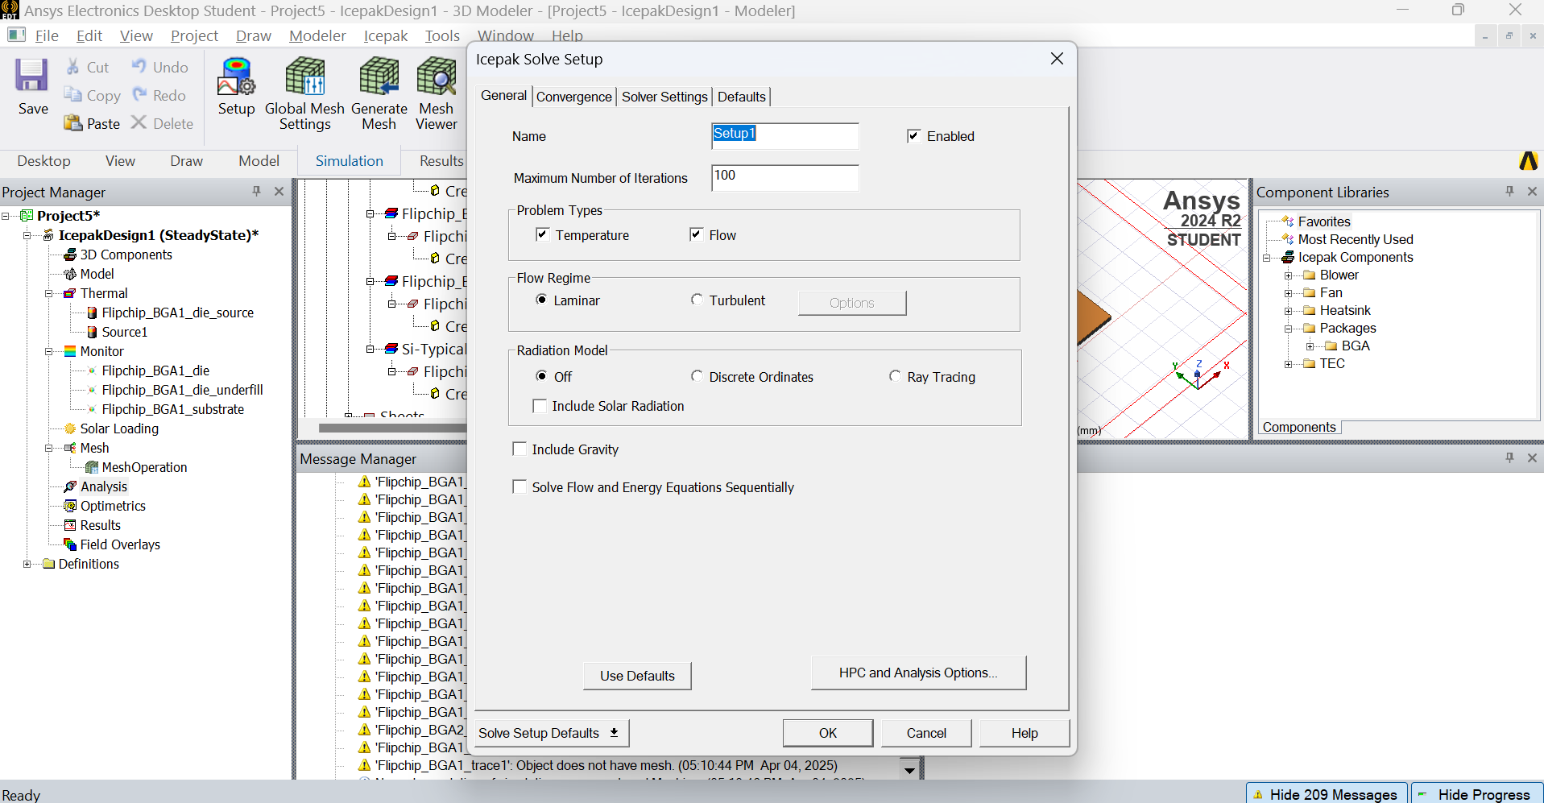
Now we can do analysis > side click on analysis >add solution > ok

Slide 21
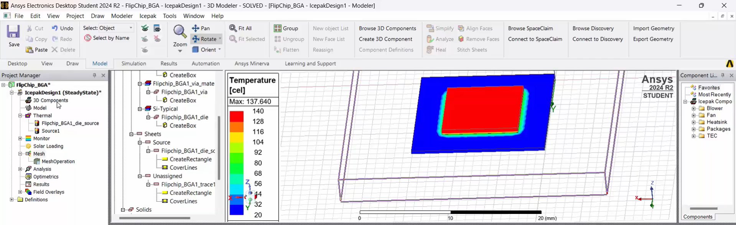
At we can get below result

Slide 22
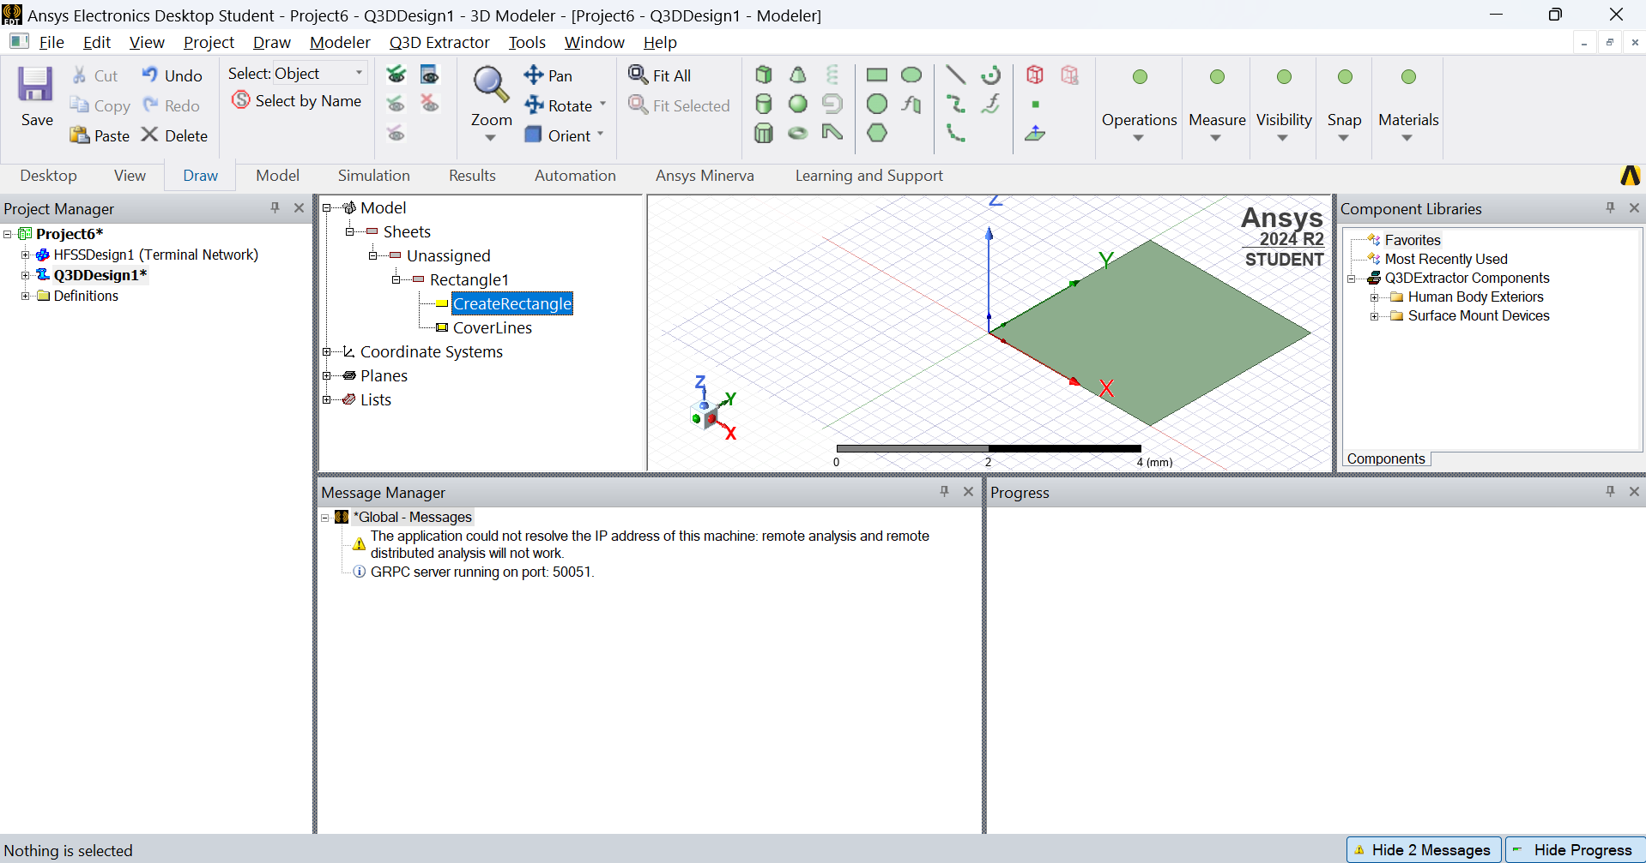
Create second project of semiconductor using Q3D Design method
Create rectangle first, size of 3mm*3mm

Slide 23
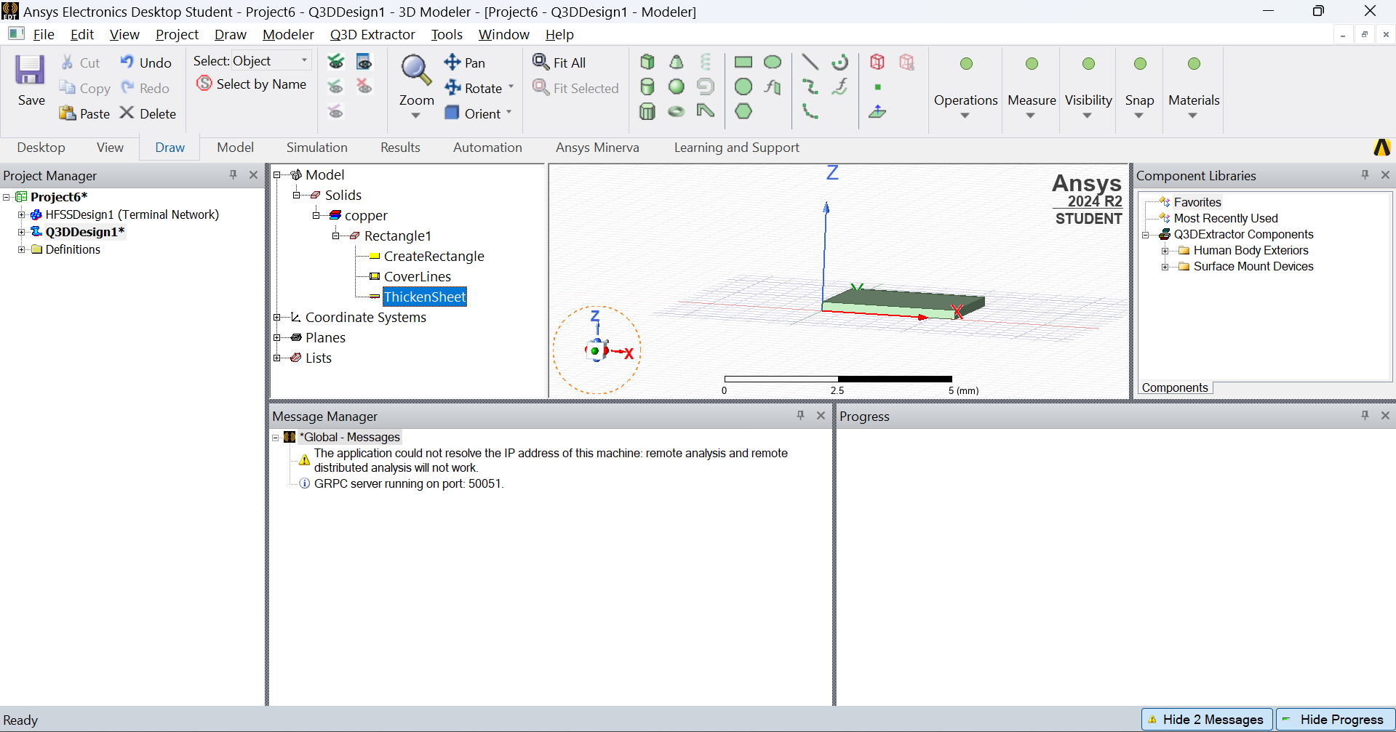
Second thing is to set the thickness of die
Select Rectangle > Modeler > Surface > Thicken sheet

Slide 24
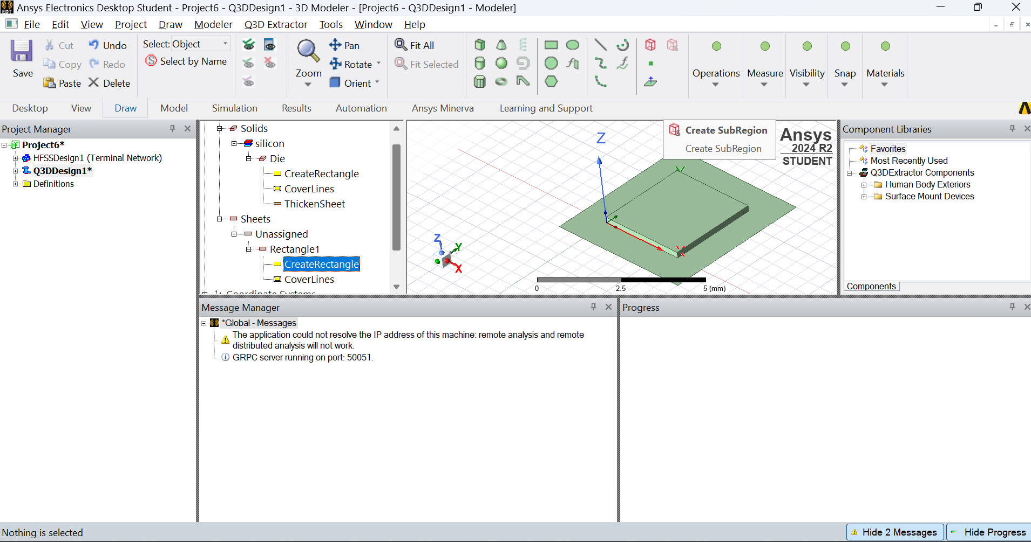
We can take as new rectangle of 5mm*5mm and dimension -1,-1,0
And die thickness is -0.5mm

Slide 25
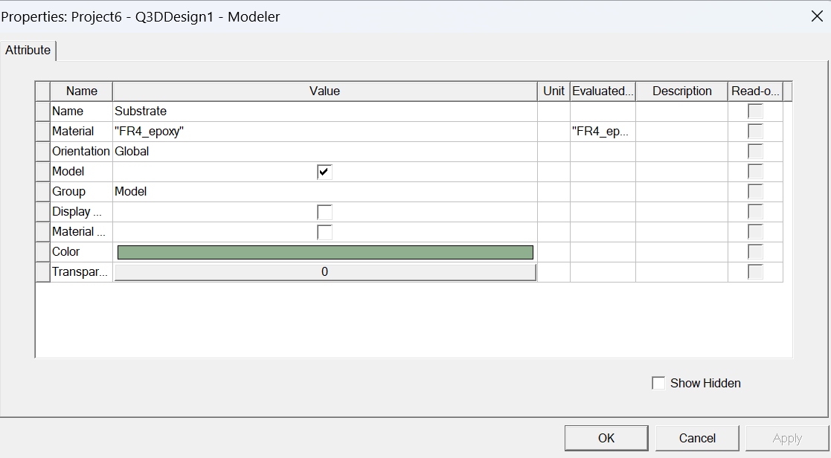
Now rename the rectangle and select the substrate materials
Right click on rectangle edit the name and materials

Slide 26
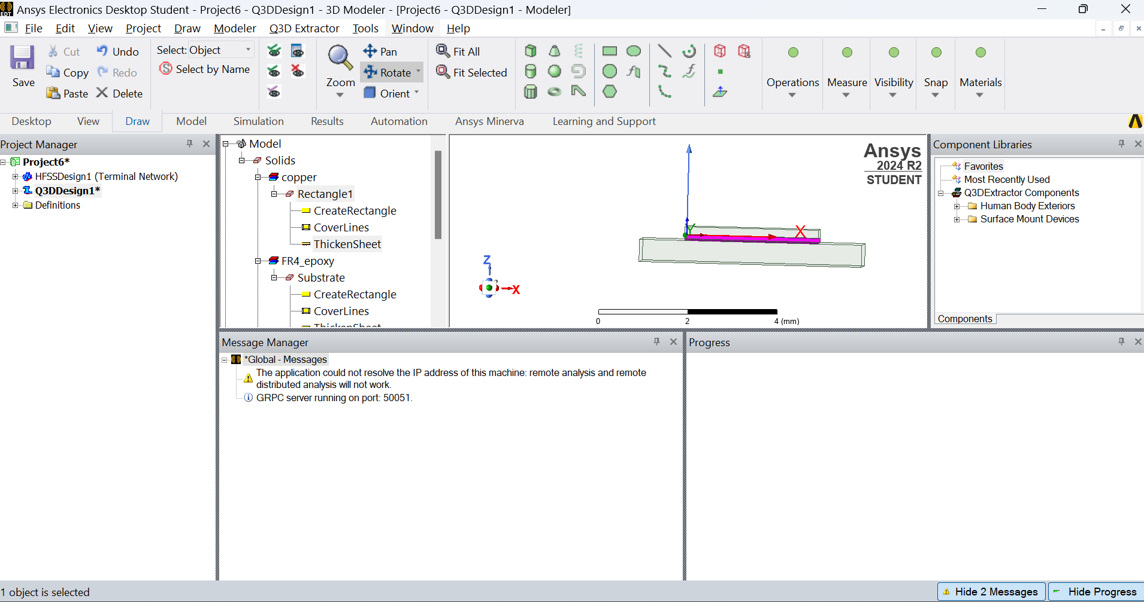
Create space between substrate and die fill die attach materials
So create the rectangle and as per above process set the size and position
Position 0,0,-0.1 and thickness -0.1

Slide 27
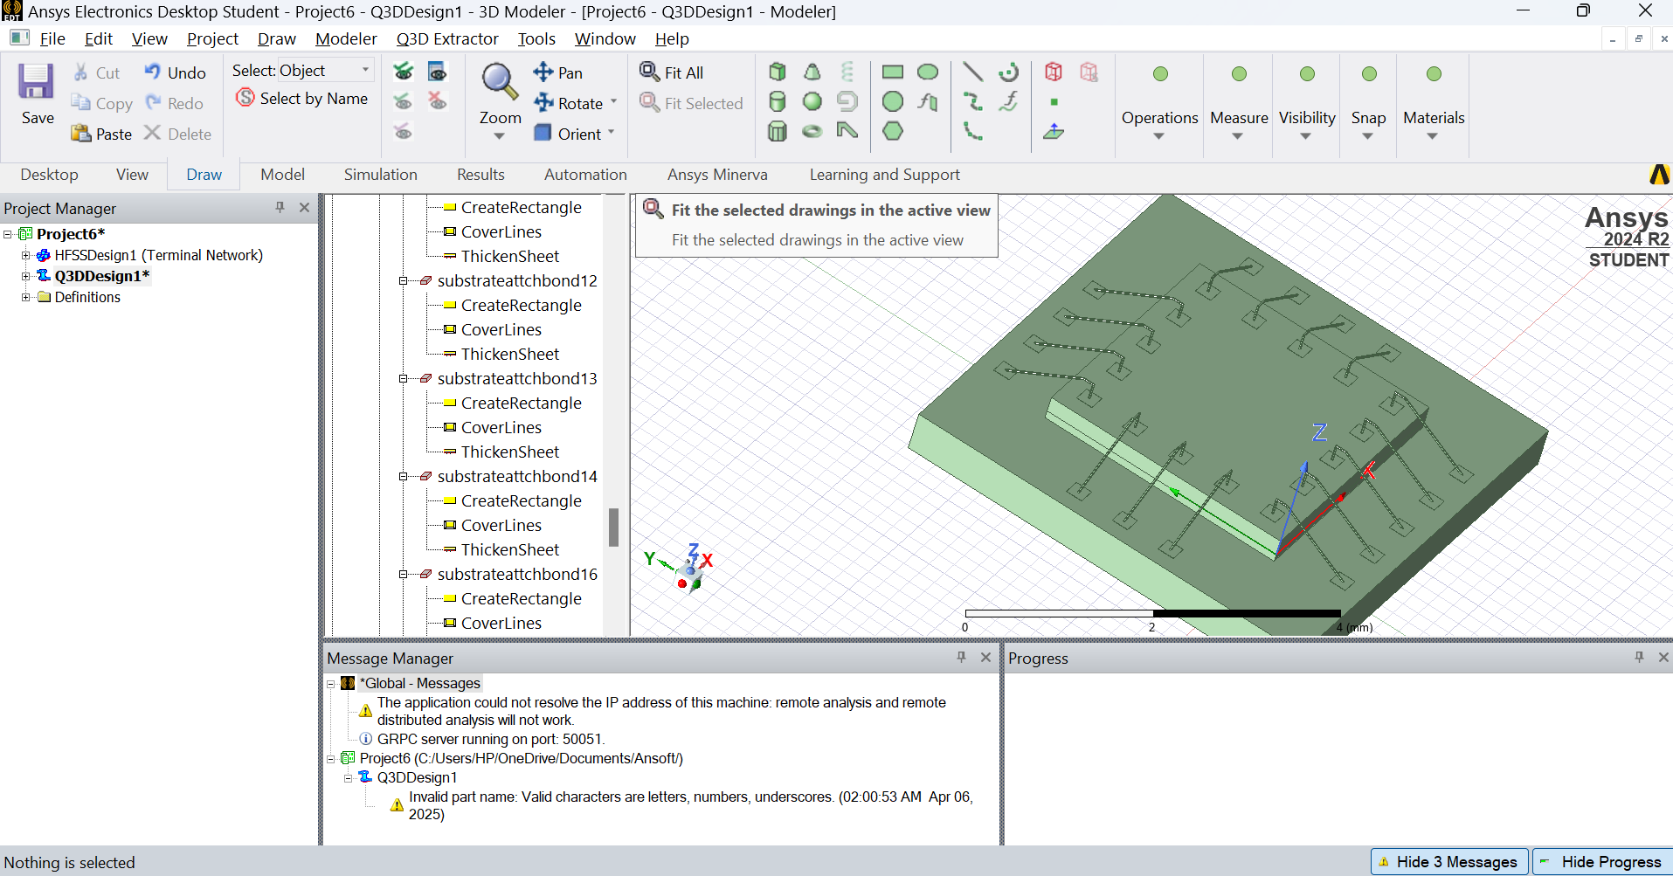
Create small rectangle on die and substrate and connect them via wirebond

Slide 28
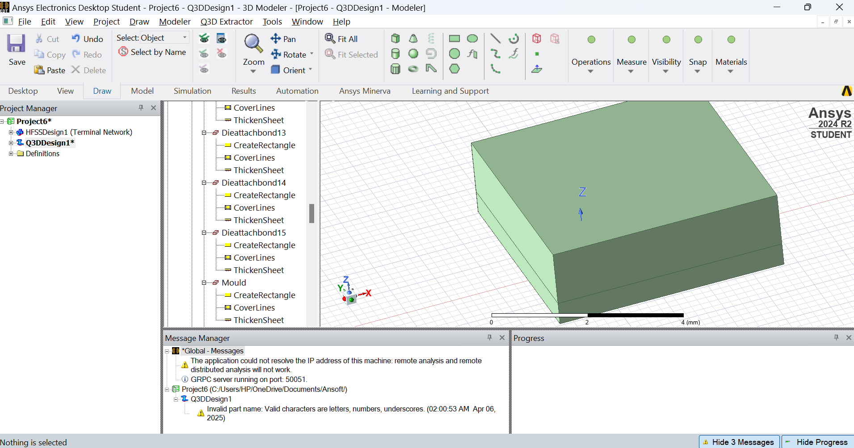
At last molding of IC as per select rectangle and set the size and position of rectangle and select it’s thickness and mould materials

